Slide 1


Slide 2
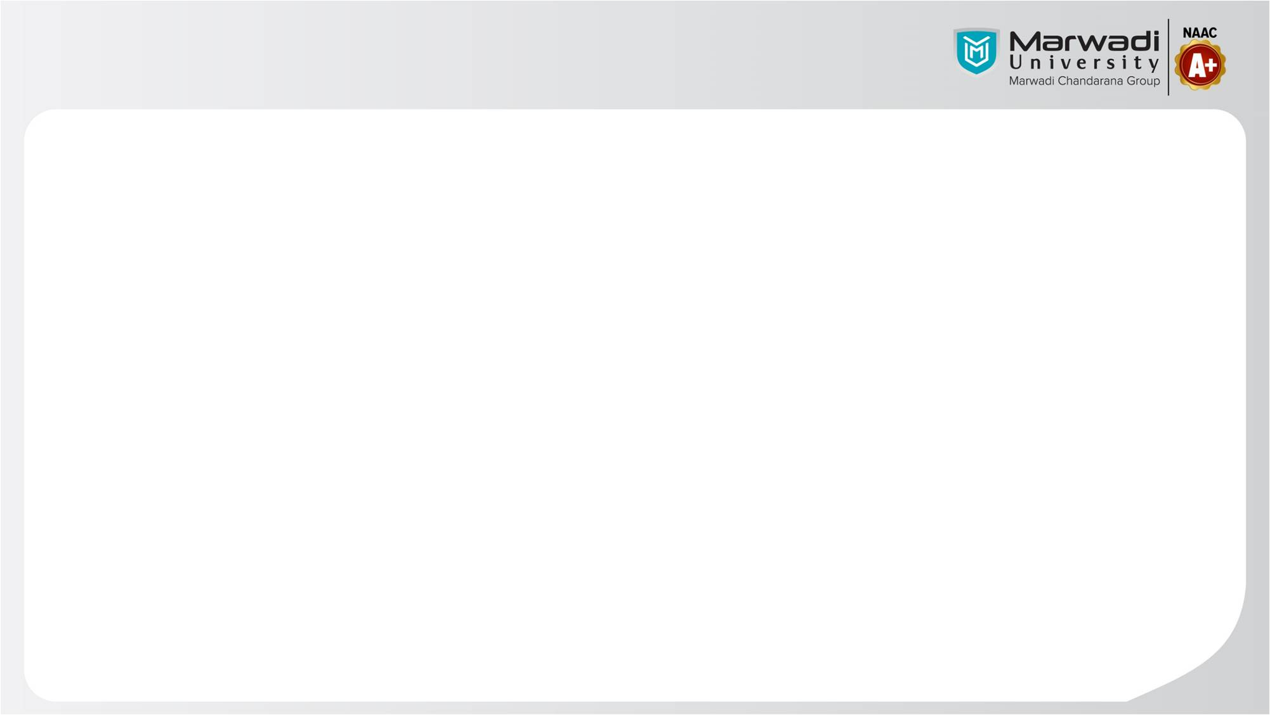

Group Introduction
Gr.No | Name
92300527222 | Vigyat Padiya
92300527203 | Dhruv Makwana

Slide 3

Customer Service Management System
This presentation explores a C language implementation of a customer service management system that utilizes a queue data structure.

Slide 4

Introduction
1
Project Purpose
2
Project Goals
The system aims to simulate a customer service desk by managing customers in a first-come, first-served order.
To organize customer service efficiently, track customer wait time, and generate reports.

Slide 5
Queue Implementation
Data Structure
Functionality
The system utilizes a queue, a linear data structure that follows a first-in, first-out (FIFO) principle. Customers are added to the rear of the queue and served from the front.
The queue enables the system to manage the order of customers waiting for service, allowing the representative to address customers in a fair and efficient manner.

Slide 6
Functionality
Customer Enqueue
Customer Dequeue
The system allows for the addition of new customers to the queue, capturing their information and placing them in the waiting line.
The system enables the removal of the customer at the front of the queue, signifying that they have been served by the representative.
Wait Time Tracking
The system tracks the time each customer spends in the queue, providing valuable data for analysis and improvement.

Slide 7




Challenges
Memory Management
Efficient memory allocation and deallocation were crucial for handling a dynamic number of customers in the queue.
Data Integrity
Ensuring that customer data was consistently stored and updated accurately was a key priority to maintain system reliability.
User Interface Design
Creating an intuitive and user-friendly interface was essential for simplifying system interaction for both the representative and the customer.

Slide 8



Conclusion
Success
Future Enhancements
The project successfully implemented a customer service management system using a queue in C language, achieving the desired goals of efficient service organization and data tracking.
Future enhancements could include adding features like priority queues for urgent cases, integrating with external databases for customer data management, or building a graphical user interface.

Slide 9


